Slide 1

AI Chatbot
With web speech api, api.ai and node.js

Slide 2
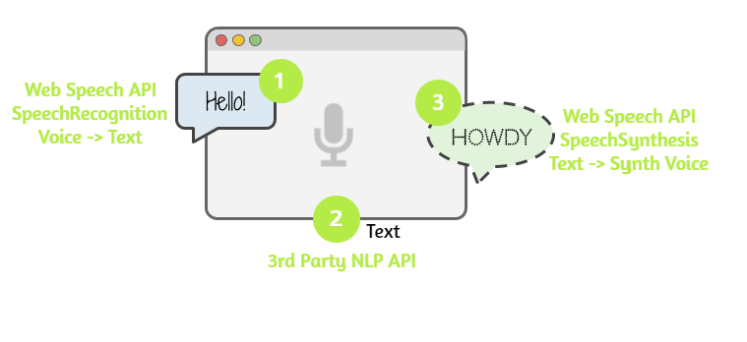
Overview
We use the Web Speech API’s SpeechRecognition interface to listen to the user’s voice.
Send the user’s message to a commercial natural-language-processing API as a text string.
Once API.AI returns the response text back, we use SpeechSynthesos interface to give it a synthetic voice.

Slide 3
Setting up node js
Install NodeJS
Delete ‘node_modules’ folder
Run npm install --save in terminal for installing the dependencies

Slide 4
Setting up api.ai
Create an account on https://dialogflow.com/ in order to obtain a Client access token
After creating the account, go to https://dialogflow.cloud.google.com/, search for “Small talk” and check ‘Enable’
On the same page, go to ‘General Settings’ (near ‘New Agent’), and search for ‘Client access token’
Copy the token ID in the ‘.env’ file
Also in the ‘.env’ file, complete the APIAI_SESSION_ID with a random string (eg. ‘Jxgkaw134’)

Slide 5
Setting up the application
In the terminal run node index.js
Open the browser and access http://localhost:5000/

